Slide 1
Abusing Native Shims for Post Exploitation
Sean Pierce

Slide 2

About Me
Sean Pierce, CISSP
@secure_sean
sdb at secure sean dot com
github.com/securesean and sdb.tools
Fancy myself a malware analyst
Disclaimer:
Not a penetration tester
Not a developer
Not an iSIGHT Rep

Slide 3
About iSIGHT
Best commercial cyber threat intelligence provider on the planet
300 Experts. 24 Languages 16 Countries.
Forward looking, adversary focused intelligence, actionable advice
Intelligence for multiple levels: executive, operational and technical
www.isightpartners.com

Slide 4
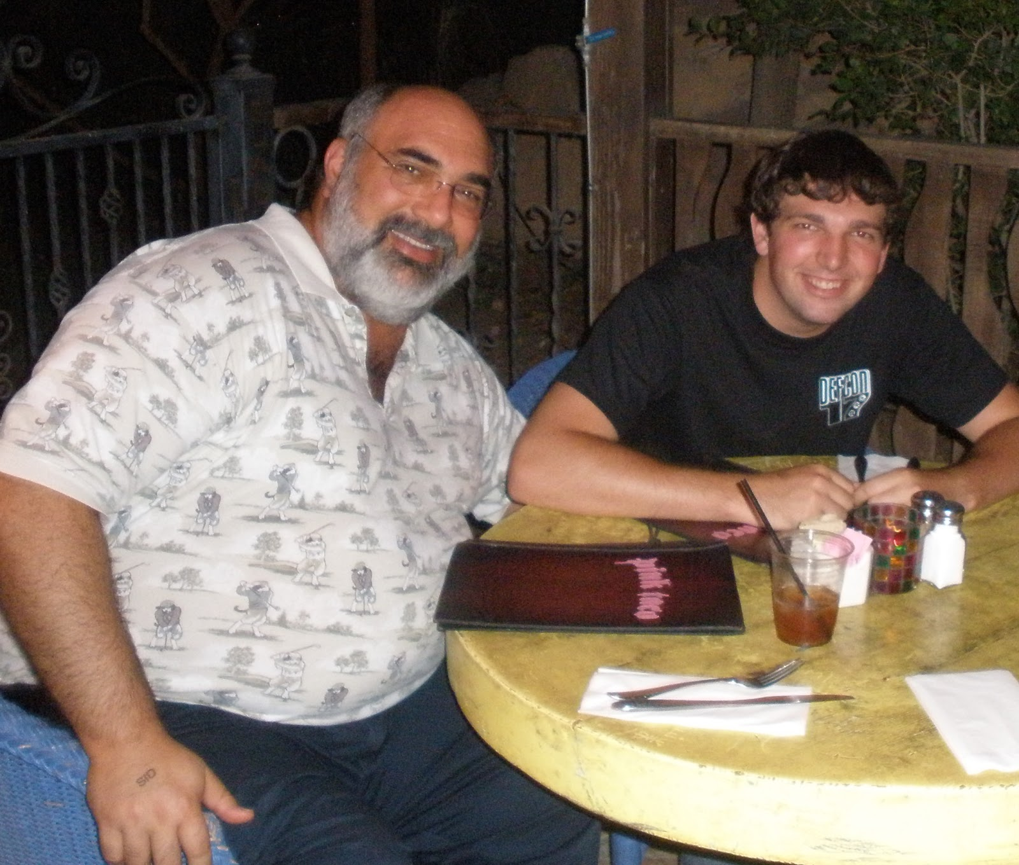
Why am I here?
Notes:
When I was 21 my father took me to las vegas. The first morning we went down to the buffet at the Rio, he ask me, ‘What do you want to do for your first day in Las Vegas?’. Just then a man walked by with a bag with the BlackHat logo, I said, “No way…” I looked at my Dad and said, ‘we have to go!’. So we found the conference and I snuck with what my dad called ‘Geek camo’ aka white letters on a black shirt and blue jeans. I sat there and listened these talks I about things I knew nothing about- I was just obviously happy just to be there surrounded by all of this. My father passed away two years ago, but I know he would be so proud of me giving a talk at this event with you fine people. And honestly, he is why I’m here.

Slide 5
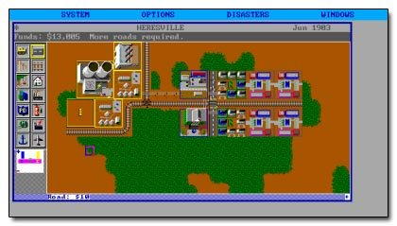

History of Application Compatibility
Third Party bugs
  Case study: Windows 95 + The SimCity®
  Flush File Cache
  Undocumented structs/API’s
OS Bugs
  Case study: Synchronous Buffer Commits
“Windows lies to 32-bit apps … but it’s ok because we can make it lie to 64-bit apps too” - Greg
Notes:
http://www.joelonsoftware.com/articles/APIWar.html
http://technet.microsoft.com/en-us/magazine/2007.04.windowsconfidential.aspx

Slide 6
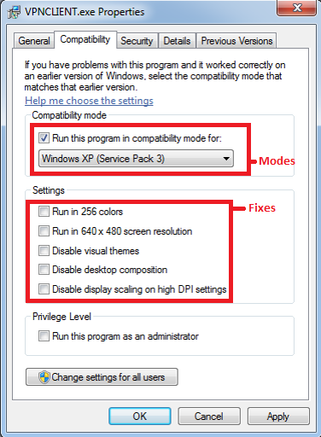
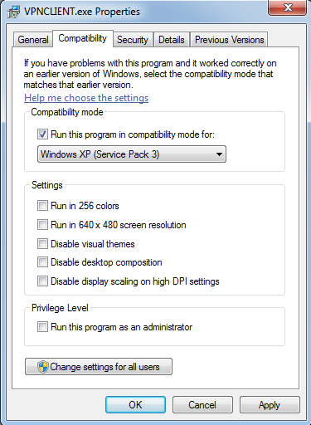
Fixes, Modes, & Shims
Fix
Mode
Shim
Fix/Mode Configurations are held in
Shim Database (.sdb) files
Notes:
When a process is created

Slide 7
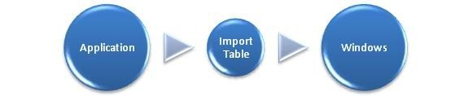
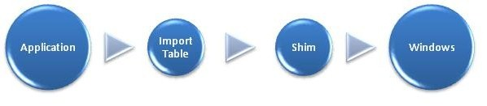
How a Process is Shimmed
Parent Process calls CreateProcess()
  Parent Process checks if process should be shimmed
  Child Process Resources and shimming code are inserted and initialized
  Typically the shim hooks the Import Address Table (IAT)
Child Process begins executing
  The shimming code intercepts
  and manipulates API calls
Notes:
Read my paper later
CreateProcess, something like it
Loader

Slide 8
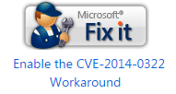
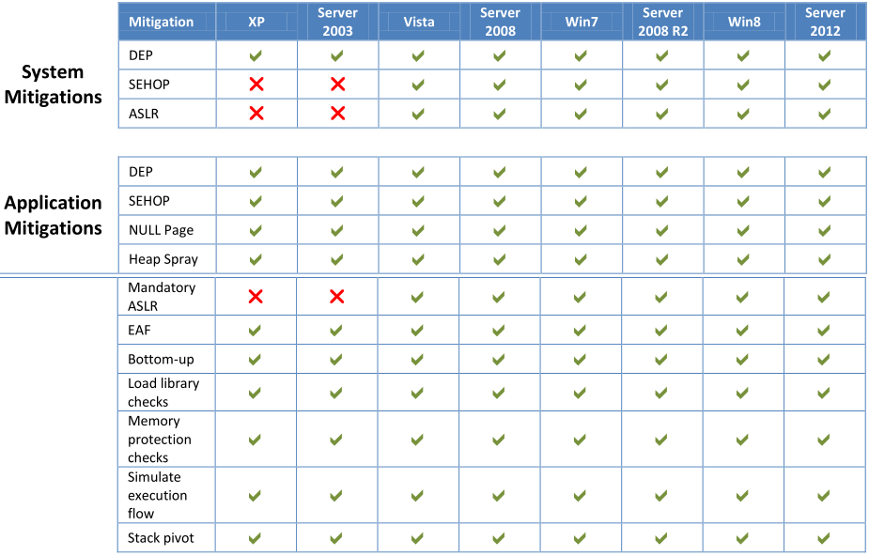
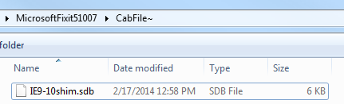
Official Uses
Microsoft Fix it Patches
EMET
Third party software
Enhanced Mitigation Experience Toolkit
Notes:
MS is awesome

Slide 9
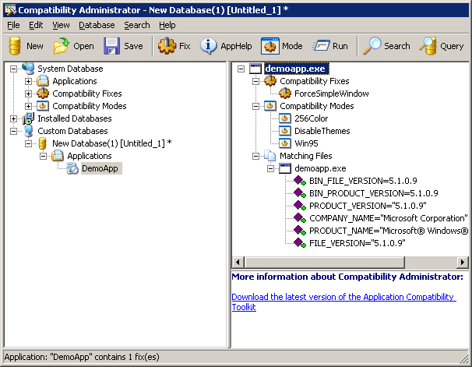
Application Compatibility Toolkit
Demo:
Undocumented trick
Create fix
Create sdb file
Install sdb file
Caveats
Public version
Does not show patch info
Need to be Admin
Notes:
Install method 1: Through compatibility admin
Install method 2: Through admin shell: C:\Windows\System32\sdbinst
Install method 3: Through sdb-explorer (easy and stealthy)
Install method 4: Through Manual reg entries

Slide 10
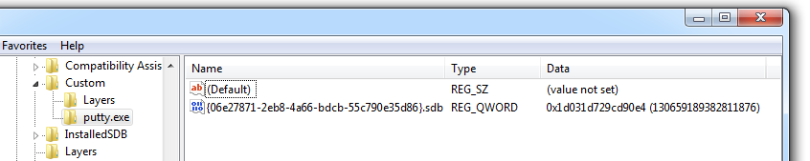
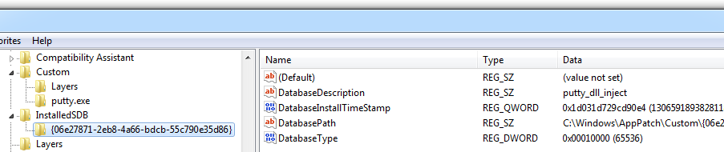
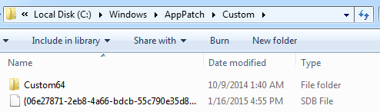
System Alterations
Registry
File System

Slide 11
Detection
Registry
Registry keys:
  HKLM\SOFTWARE\Microsoft\Windows NT\CurrentVersion\AppCompatFlags\Custom
  HKLM\SOFTWARE\Microsoft\Windows NT\CurrentVersion\AppCompatFlags\InstalledSDB
Default File Locations
  C:\Windows\AppPatch\Custom\
  C:\Windows\AppPatch\Custom\Custom64\
Notes:
Live boot attack is possible

Slide 12
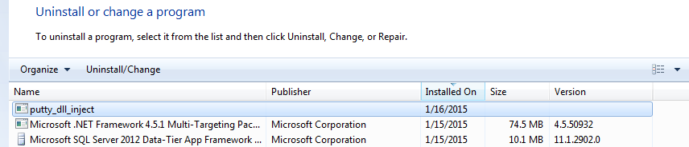
Detection
Registry
Check add/remove programs
only with sdbinst.exe
Yara/Snort rules

Slide 13
Detection
Registry
Check add/remove programs
Yara/Snort rules
rule sdb
{
meta:
author = "Sean Pierce"
description = "Shim Database files"
strings:
$magic = { 73 64 62 66 }
condition:
$magic at 8 and
md5 != "B02B4B8924F019BDE57484A55DC5CA57" and
md5 != "BA17F2DA98A8A375D22CB33C8E83A146" and
md5 != "EC9D5F0AE38EC4A97E70960264B7D07D" and
md5 != "4C7B2F691885878EDBAE48760A7E3FB9" and
md5 != "1D8C1280D38C526C7041E72DB8D70DC1" and
md5 != "8006552125C9D590843192543668BB0B"
}

Slide 14
Post Exploitation
Targeted Persistence. Similar to, but more powerful than
HKLM\Software\Microsoft\Windows NT\CurrentVersion\Image File Execution Options
API Logging
Kill any app
Catch all creds for an app
Redirect app logs
Snoop/redirect network traffic for an app
Trojanize any app
Force vulnerable DLL loading
Subvert system integrity
UAC prompt bypass (Patched with KB3045645)
Malware obfuscation
Notes:
Image File Execution Options is known, Persistence is not new
trojanize explorer.exe
MS12-058
MS08-067
side loading dll
load via unc paths

Slide 15
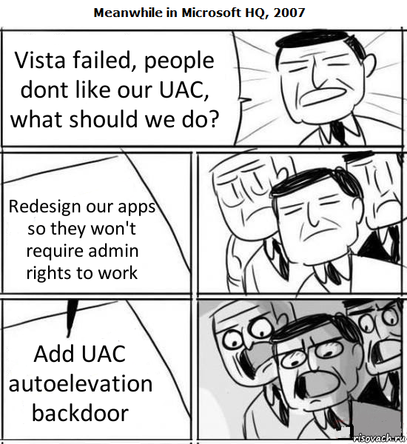
Demo UAC bypass
UAC application manifest flag
sdbinst.exe
SndVol.exe
cleanmgr.exe
control.exe
syskey.exe
70+ classically that are signed
<asmv3:windowsSettings xmlns="http://schemas.microsoft.com/SMI/2005/WindowsSettings">
<autoElevate>true</autoElevate>
</asmv3:windowsSettings>
Note: This was changed in KB3045645
Notes:
Full list: http://withinwindows.com/2009/02/05/list-of-windows-7-beta-build-7000-auto-elevated-binaries/
More in x64 and WinSXS

Slide 16
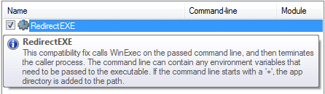
UAC bypass
"C:\Windows\system32\sdbinst.exe" /q "C:\Users\%USERNAME%\AppData\Local\Temp\\..\..\LocalLow\com.%USERNAME%.sdb"
Notes:
Full list: http://withinwindows.com/2009/02/05/list-of-windows-7-beta-build-7000-auto-elevated-binaries/
More in x64 and WinSXS

Slide 17
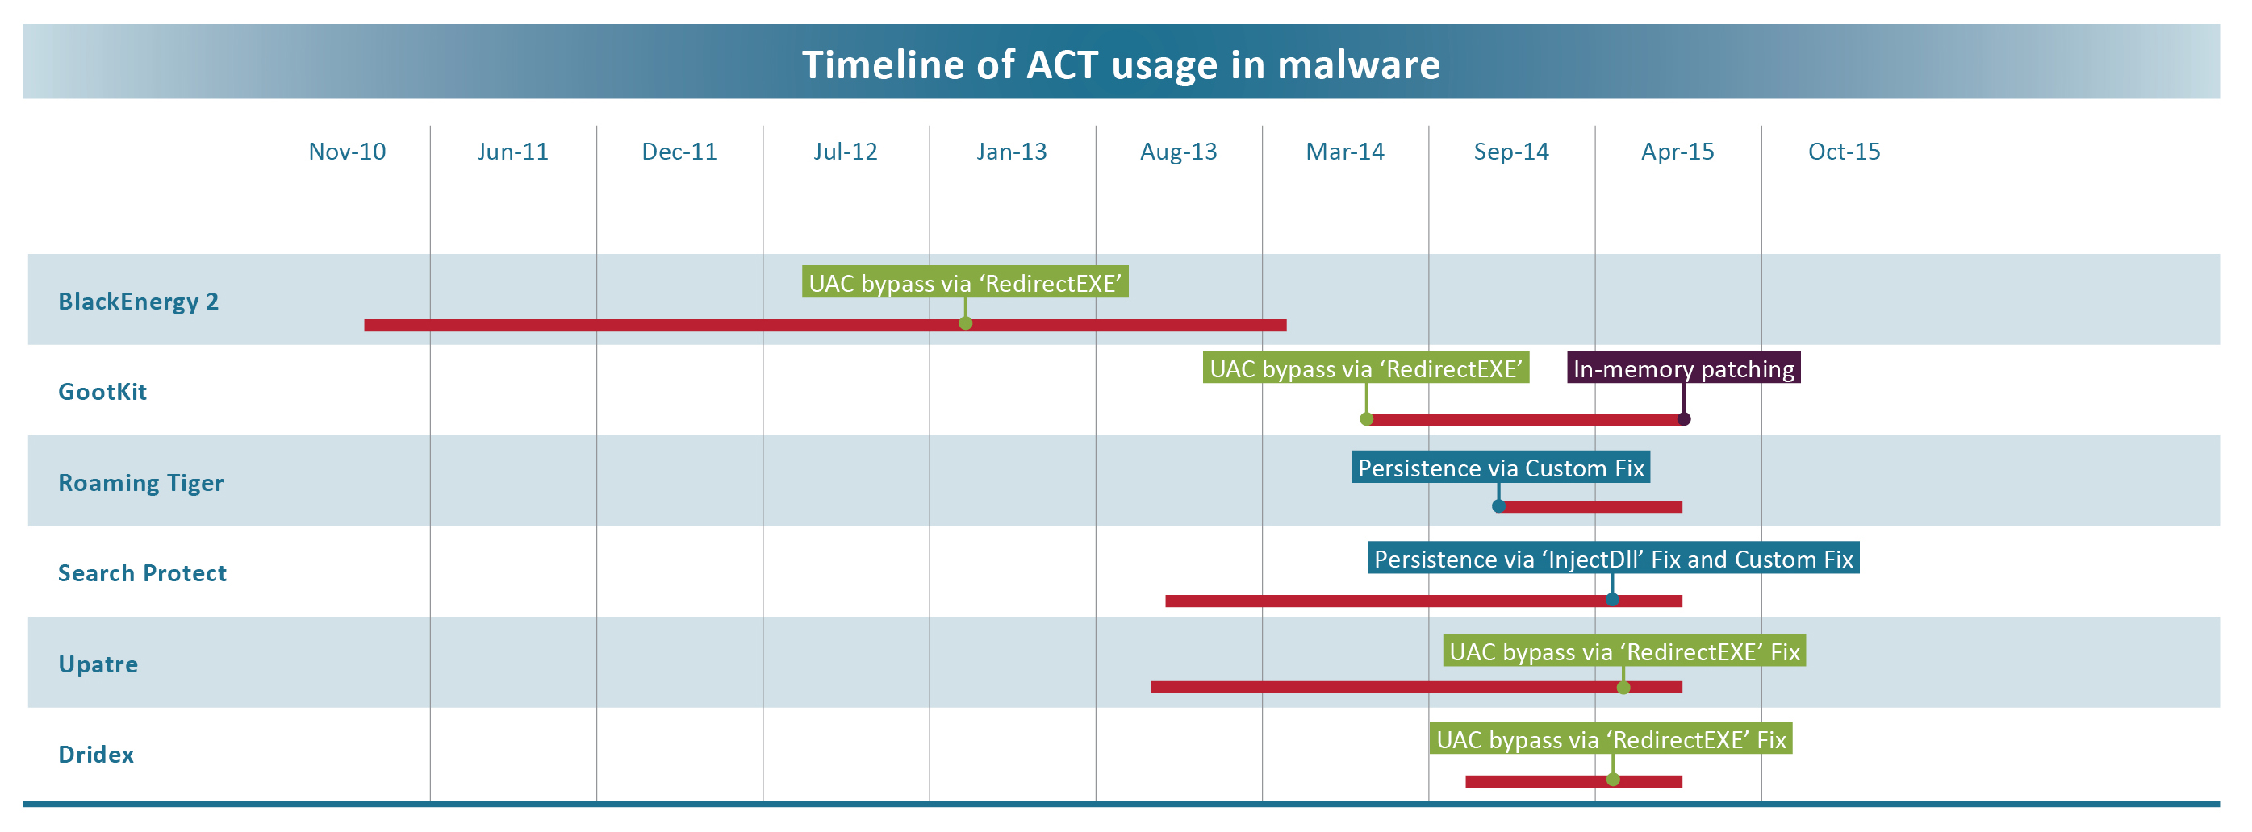
In the Wild
Notes:
In memory patching

Slide 18
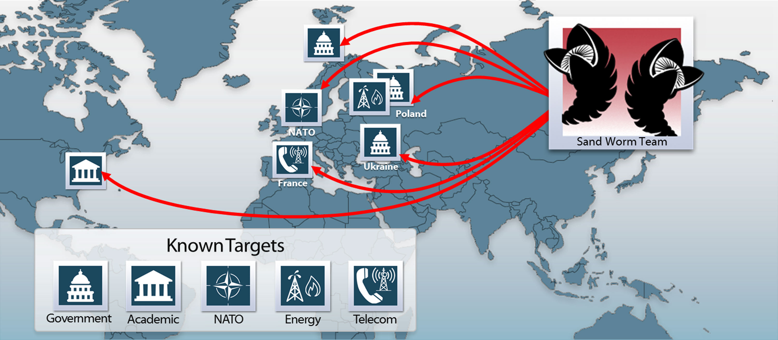
BlackEnergy 2
Notes:
June 2007, rootkits and 64-bit plugins.
cyber-crime & cyber-espionage
April 2013 UAC bypass
‘DisableNXShowUI’ Fix to disable Data Execution Prevention (DEP)

Slide 19
Roaming Tiger
Notes:
Eset’s Anton Cherepanov at ZeroNights 2014
Jon Erickson’s sdb-explorer.exe
registered specially crafted 32-bit and 64-bit shim databases for ‘explorer.exe’

Slide 20
Making a Custom Fix
Make a DLL that Exports:
  GetHookAPIs(char *, ushort *, ulong *)
  NotifyShims(char *, unsigned __int16 *, unsigned __int32 *)
Make an .sdb file that specifies that DLL

Slide 21
Examples of Offensive Uses
I prefer stealth and misdirection
Malware
  Anti-Analysis
  Old to New
Putty
  InjectDll with Metasploit, PuttyRider
Firefox
  CorrectFilePath for the profile
Autoruns
  VirtualRegistry to hide malware
Shim explorer.exe
  Hot patch
Notes:
PuttyRider Adrian Furtunã
Maniipulate malware at runtime, Change IP, domain, persistence, hard-coded files, paths, reg keys

Slide 22
Maliciously Compatible Software
Benign Executables
  ‘InjectDll’ and ‘LoadLibraryRedirect’ Fixes via a UNC path
  Patching in new code and/or utilizing existing code akin to
  ROP (Return Oriented Programming) chains
Dependently Malicious Executables
  ‘kill switch’
  ‘IgnoreException’ Fix
  Hot patching instructions to redirect program flow
Obfuscated Executable
  The target executable will fail completely without the shim.
Notes:
Build the packer into the shim
Crappy to new

Slide 23
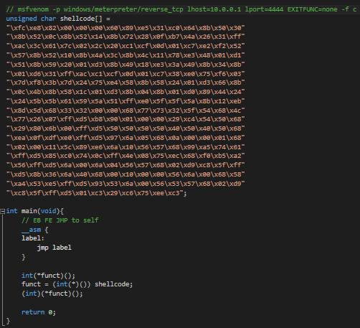
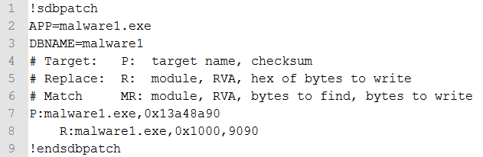
Simple Malware Anti-analysis

Slide 24
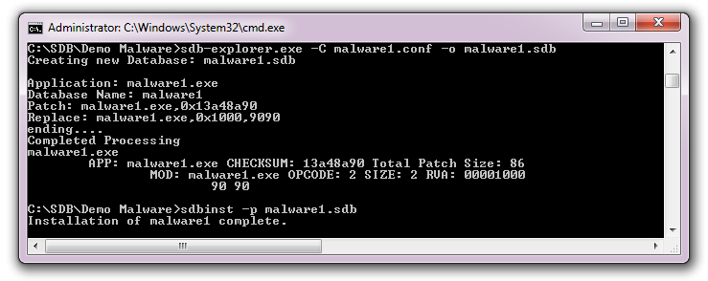
Simple Malware Anti-analysis

Slide 25
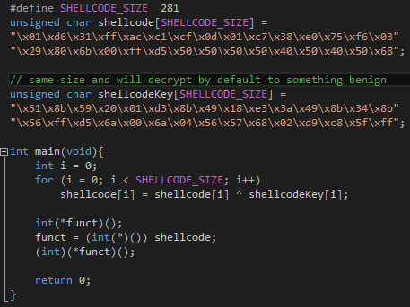
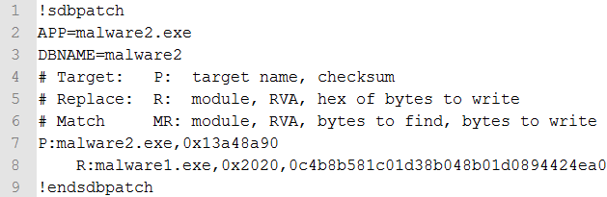
Malware Obfuscation
ShellcodeKey will be replaced at runtime to decrypt malicious code
Neither the patch nor the target program will have the real shellcode
Notes:
Key same size, by controlling key, possible to decrypt to anything,

Slide 26
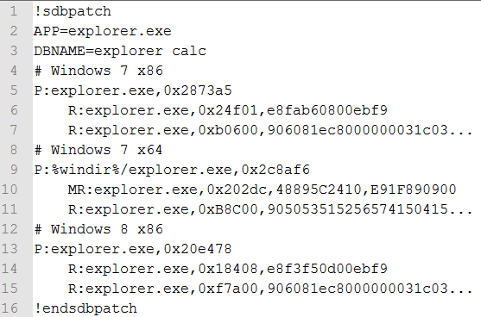
Simple Persistence Explorer Shim

Slide 27
Current Prevention
Disable via Group Policy
(not recommended)
Remove Shim Engine
(NOT recommended)
Remove sdb installer: C:\Windows\System32\sdbinst
(not effective)
No Admin access
Notes:
What can we do?
I think IE also relies on the shim engine to switch between compatibility modes for rendering
Install.exe

Slide 28
Current Tools
Microsoft Application Compatibility Toolkit (public version)
sdbinst.exe
sdb-explorer.exe
shims.exe
Shim Cache Parser
… None help with prevention or detection of malicious shims…

Slide 29
New Tools
Detect | Shim-File-Scanner Scans Files/Folders for non-default shims Checks registry for installed shims Shim-Process-Scanner Will search all processes for PEB shim flags Checks for Shim App Helper DLL’s are in the process space Shim-Process-Scanner-Lite Simple script to find loaded Shim App Helper DLL’s
Prevent | Shim-Guard Detects and alerts on newly installed shims Shim-Guard-Lite Flexible Powershell based script Alerts on newly installed shims
Respond | Sdb Ingest Module (Autopsy® ) Searching for SDB files and analyzes them Sdb Scanner (Volatility) Scans for Shimmed processes
Notes:
All Via:
Loaded Dll’s
Registry
Undocumented PEB flags
Magic Number: Yara/Snort rules

Slide 30
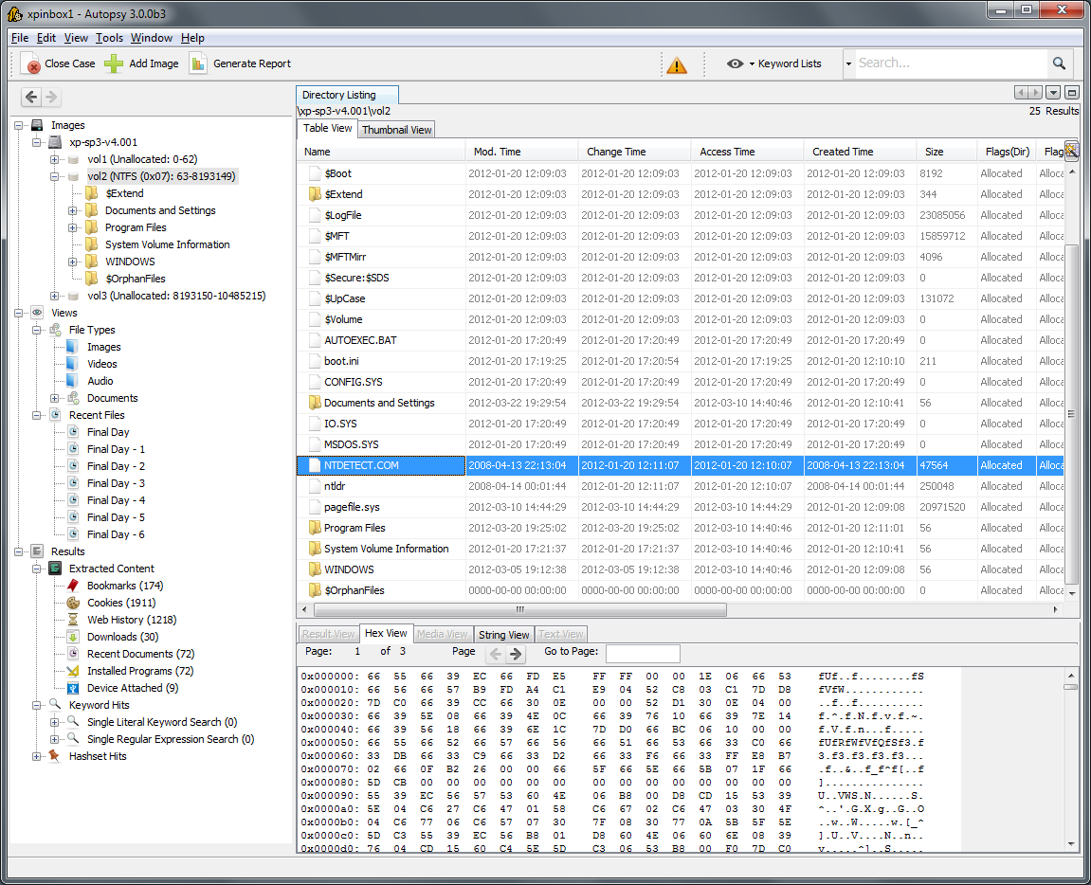



New Tools: Sdb Ingest Module & Volatility Plugin
Autopsy® is an open source graphical forensic file/drive analysis kit built on the command line tools in Sleuth Kit®
An Ingest Module is an Autopsy plugin that searches for and displays information about sdb files via sdb-explorer
Volatility is an open source advanced memory forensics framework.

Slide 31
Shim Fix Examples
“no shim is available to bypass the Windows 7 User Account Control” –Microsoft
  RedirectEXE Fix
  LoadLibraryRedirect Fix
“This limitation is by design and is intended to reduce the risk to system security posed by allowing non-Microsoft parties to inject potentially harmful code into the loading process” –Microsoft
  InjectDll Fix
  Custom Fixes
“you are not opening any additional security vulnerability. ” -Microsoft
“you cannot use shims to bypass any security mechanisms present in Windows”
-Microsoft
  DisableAdvancedRPCClientHardening, Fix
  DisableWindowsDefender Fix
  DisableASLR Fix
  DisableSeh Fix
  DisableNX Fix
Notes:
https://technet.microsoft.com/en-us/library/dd837644(WS.10).aspx
This is not new:
https://forums.geforce.com/default/topic/748213/geforce-drivers/nvidia-optimus-big-problem-with-my-gtx660m/2/
https://www.cert.org/blogs/certcc/post.cfm?EntryID=95

Slide 32
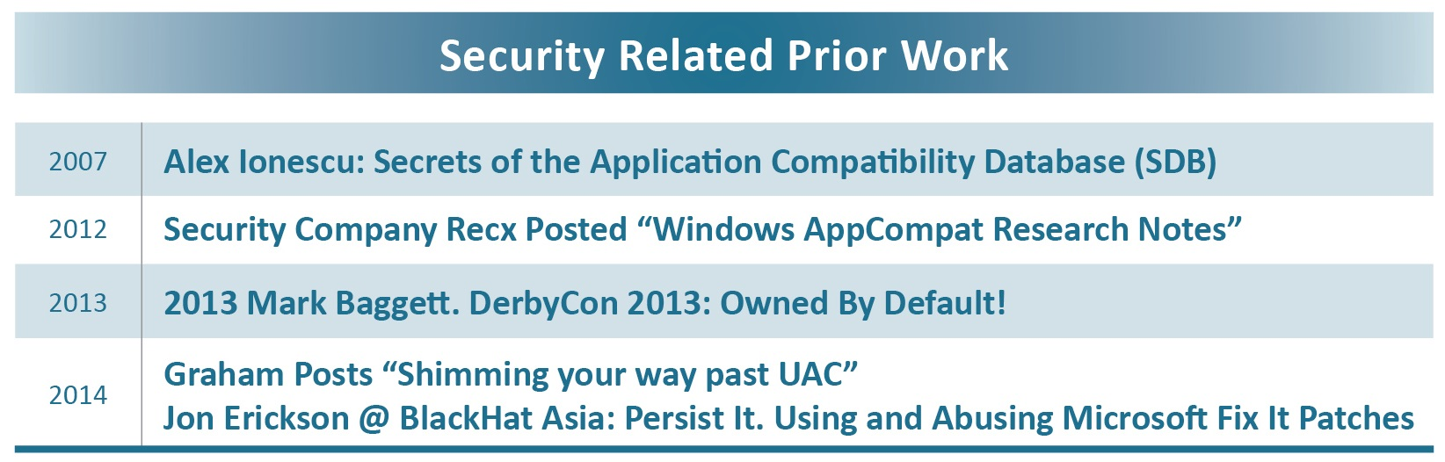
Prior Information

Slide 33
Special Thanks
Peeps: Jon, Greg, Wyat, & Patrick,
Special Thanks to Elma, Ross, Zach, and 9gag.com
Other Resources:
  iSIGHT blog
  http://blogs.msdn.com/b/oldnewthing/ - Raymond Chen
  http://blogs.msdn.com/b/cjacks/ - Chris Jackson
  http://www.alex-ionescu.com/ - Alex Ionescu
Misc.
  I apologize that Application Compatibility is the source of so much pain
Notes:
Special Thanks - Without whom, I would have finished this a lot earlier…
http://www.cracked.com/article_18808_7-reasons-computer-glitches-wont-go-away-ever.html

Slide 34
Questions?
Example: Is there anything that can’t be shimmed?
github.com/securesean and sdb.tools
@secure_sean
sdb at secure sean dot com
(In case you suddenly realized I’m cool)

